Slide 1
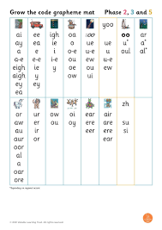
Year 1
Phonics Screening Check

Slide 2
What is Phonics?
Children begin to learn phonics (sounds) in the Early Years; both Nursery and Reception. They then continue to learn phonics in Year 1 and year 2 (if necessary).
We use the Little Wandle programme to teach children phonics.
Once children begin to blend sounds together, they use this knowledge to read words.
Once a child’s reading has progressed, they develop segmenting for writing skills; breaking a word up into sounds to spell.

Slide 3
What is the Phonics Screening Check?
The DfE announced that all children in Year 1, in England, would be taking part in a statutory Phonics Screening Check. This has continued each year. This usually takes place in the second week of term 6.
The Phonics Screening Check is designed to confirm whether individual children have learnt sufficient phonic decoding and blending skills to an appropriate standard.
Passing the phonic screening check does not mean your child is a fluent reader.
They will continue phonics lessons and regular reading sessions.
Notes:
In the past the requirement has been for the children to achieve 32 or more in order to pass but this is only a guide and could change.
It is worth remembering that whilst we can with lots of practice and repetition prepare the children for the test and they will pass, this does not in itself ensure they will meet the required standard in reading and will have a sufficient understanding of what they are reading. Continuing to read and share stories with children that extend and challenge their vocabulary is vitally important.

Slide 4
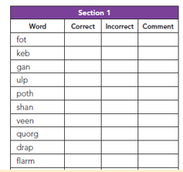
What happens during the check?
The check contains 40 words.
Each child will sit one to one and read each
word aloud to their teacher.
The check will take approximately 4-10 minutes per child although all children are different and will complete the check at their own pace. The check can take place over more than one day if necessary.
The list of words the children read is a combination of 20 real words and 20 pseudo words (nonsense words).

Slide 5

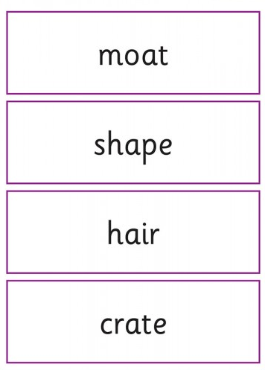
Example of the Real Words:

Slide 6

Pseudo Words (Nonsense Words)
The pseudo words will be shown to your child with a picture of a monster. This provides the children with a context for the pseudo word which is independent from any existing vocabulary they may have.
Pseudo words are included because they will be new to all pupils. They do not favour children with a good vocabulary knowledge or visual memory of words. It is purely to assess their ability to phonetically decode.
Notes:
Emphasis is on phonic ability in the test . The children will not be required to explain meanings of words.

Slide 7
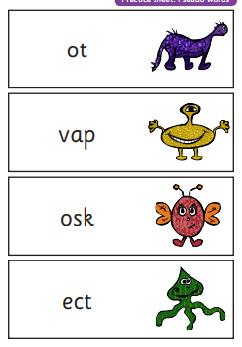
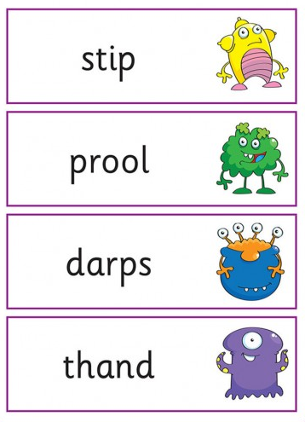
Example of the monster words:
Notes:
Children can identify sounds with dots and dashes as they “sound out”- show example of this.

Slide 8
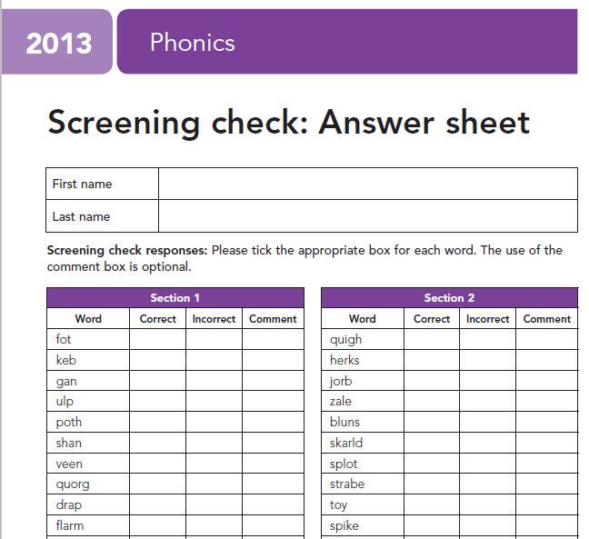

We put a tick in the correct column if the child reads the word accurately.
We also tick the incorrect column if the child does not get the word correct because we do not want them to feel anxious if they see a cross or a dot which could then impact negatively on the rest of the phonics check.

Slide 9
Reporting the results
By the end of the Summer term, all schools must report the results to the Local Authority.
Data from the check will be used by DfE to determine which pupils have not met the expected standard in phonics.
Y1 Children not meeting the standard will be able to re take the check in Year 2.
You will be notified of the results after they have been submitted and collated by DfE. Schools must report pupils’ results to parents in their annual reports.

Slide 10
Threshold
Schools are not made aware of the threshold until the phonics checks have been administered to avoid maladministration (cheating).
The threshold could be anywhere between 32-36. Previous years have been 32.

Slide 11

How can I help my child at home?
Play lots of sound and listening games with your child e.g. ‘I spy with my little eye something beginning with ‘th’ / the ‘ee’ sound in it…’
Go on www.phonicsplay.co.uk or
https://home.oxfordowl.co.uk/
Listen to pronunciation of sounds: https://www.youtube.com/watch?v=EYx1CyDMZSc
Read as much as possible to and with your child - encourage your child to sound out any words they are unsure of.

Slide 12
Thank you for listening!
If you have any questions please ask your class teacher

