Slide 1


SEN Coffee Afternoon
March 2026
Mrs Atkiss – Resource Base Manager and SENCo
With the support of:
Angela Bayliss – SEND Governor
Dominic Haydn-Davies – Inclusion Lead
Lauren Morgan – Phonics Lead
Hannah Atkinson - Wiltshire Mental Health Support Team
Zena - Wiltshire Parent Carer Council
School Nursing Team – send their apologies

Slide 2

SEND Reform: Putting Children and Young People First Proposals
Universal Offer
Three Levels of Support:
Targeted
Targeted Plus
Specialist
3. Individual Support Plans
4. ECHPs for children with complex needs.
5. Experts at Hand offer
At Kiwi we are ensuring your children already have these packages available to them through our SEND Systems and processes.

Slide 3
Universal Offer – Ordinary Available Provision to All Learners (OAPAL)
Area of Need | Ordinarily Available Provision | Classroom Adaptations to Support Success
Cognition and Learning | • Assess–Plan–Do–Review cycles to monitor progress. • Identification of starting points, strengths and interests. • Use of a range of assessment strategies. • Explicit modelling of learning and clear success criteria. • Use of EEF 5-a-day principles and adaptive teaching. • Pre-teaching of subject vocabulary and concepts. • Multi-sensory teaching and use of concrete resources. • Teaching metacognitive and independent learning strategies. | • Tasks broken into smaller steps and scaffolded. • Use of visual supports, writing frames and task planners. • Alternative methods of recording (oral, diagrams, technology). • Additional processing time and repetition of instructions. • Use of manipulatives and practical resources. • Flexible grouping and targeted adult support where appropriate.

Slide 4

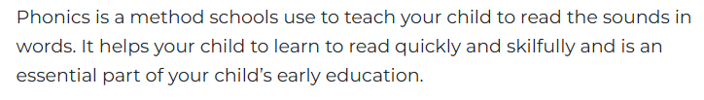
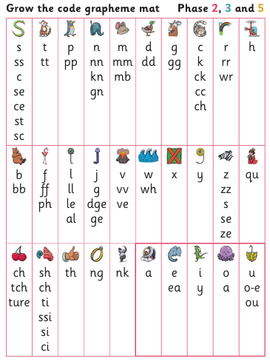
Little Wandle Phonics
Lauren Morgan – Phonics Lead
Overview - Letters and Sounds

Slide 5
Universal Offer – Ordinary Available Provision to All Learners (OAPAL)
Area of Need | Ordinarily Available Provision | Classroom Adaptations to Support Success
Communication and Interaction | • Communication-friendly classrooms. • Explicit teaching and modelling of vocabulary. • ‘Match +1’ language modelling strategies. • Opportunities to practise and apply new vocabulary. • Total communication approaches (visuals, gestures, modelling). • Adults modelling correct language and social interaction. | • Visual timetables and visual instructions. • Key vocabulary displayed with images or symbols. • Clear demonstrations before tasks. • Structured talk opportunities (talk partners, sentence stems). • Social stories or scripts to support understanding. • Adult prompts to support conversation and turn-taking.

Slide 6
Universal Offer – Ordinary Available Provision to All Learners (OAPAL)
Area of Need | Ordinarily Available Provision | Classroom Adaptations to Support Success
Social, Emotional and Mental Health (SEMH) | • Trauma-informed and relational approaches. • Calm and purposeful learning environments. • Promotion of belonging, wellbeing and resilience. • Recognition of behaviour as communication. • Restorative approaches to repair relationships. • Explicit teaching of routines and expectations. • Development of emotional literacy and self-regulation. | • Access to calm spaces within classrooms. • Emotional check-ins and regulation strategies. • Clear and predictable daily routines. • Positive reinforcement and calming scripts. • Support from trusted adults when needed. • Flexible seating or movement breaks.

Slide 7
Universal Offer – Ordinary Available Provision to All Learners (OAPAL)
Area of Need | Ordinarily Available Provision | Classroom Adaptations to Support Success
Sensory and/or Physical Needs | • Reasonable adjustments to the environment. • Awareness of sensory triggers and environmental factors. • Structured classroom environments and clear routines. • Visual supports to structure spaces and activities. • Preparation for transitions and changes. | • Sensory tools such as wobble cushions, fidgets or sensory chews where appropriate. • Adapted seating arrangements. • Reduced sensory overload (lighting, noise levels). • Movement breaks to support regulation. • Adapted equipment such as pencil grips, writing slopes or larger print resources.
At Kiwi we have all of these provisions available for every learner.
These packages are available at any time.
We are making our classrooms EHCP ready!

Slide 8
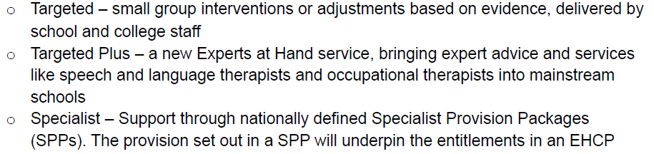
Three Levels of Support
How: At Kiwi, we have 4 waves of support available for our learners.
Wave 1: Individual Education Plan – Targeted (12 weekly review)
Wave 2: SEND Support Plan – Targeted/Targeted Plus (12 weekly review)
Wave 3: SEND Support Plan (High Needs) – Targeted Plus (6 weekly review)
Wave 4: Education Health Care Plan – Specialist (6 weekly review and Annual)
Why: Early Intervention and the Right Support at the Right Time

Slide 9
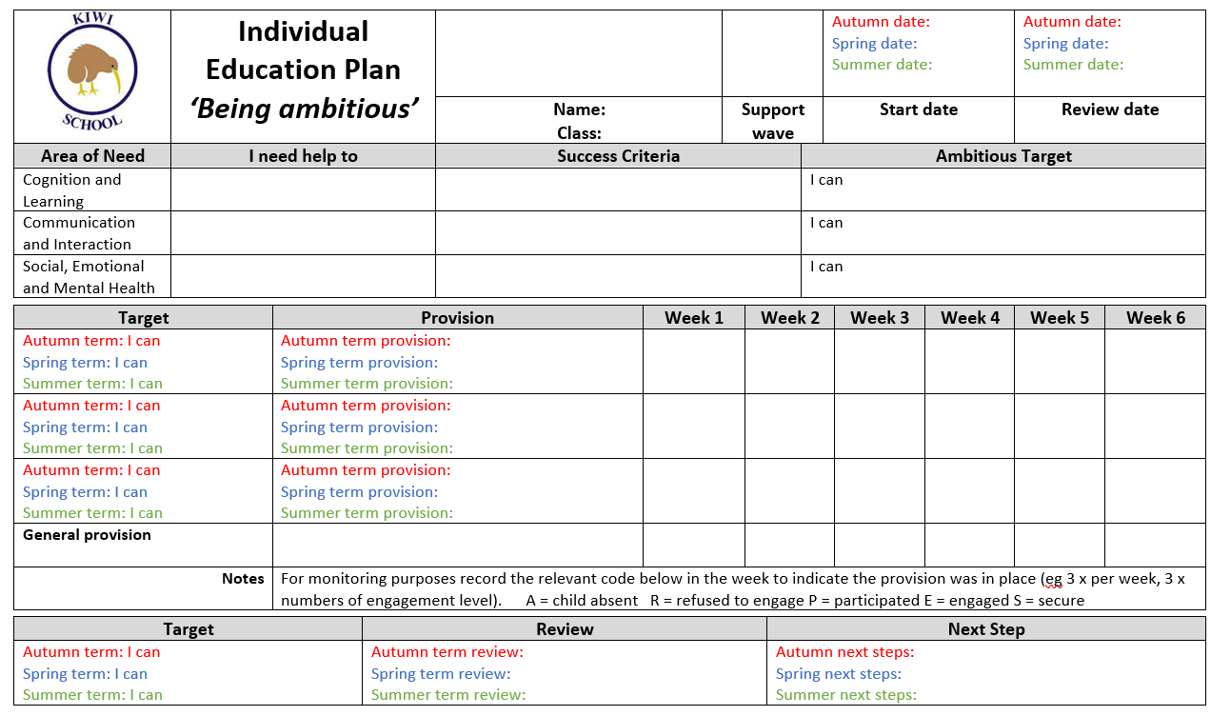
Individual Support Plans

Slide 10
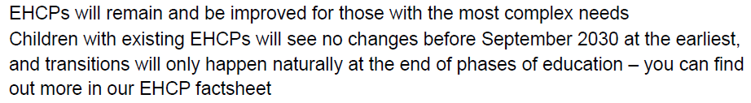
EHCPs – Education Health Care Plans
Important to note:
EHCPs will not change for any child who is in mainstream education until they finish the current phase of education (primary to secondary).
The first cohort of children to transition will be those at the end of primary education in 2029/2030 – Year 1 children with an EHCP.
At this point, it will be reviewed by the LA to see if they need a Specialist Provision Package. If they do not, they will move to one of the three layers of support.
Any child who has a special school place in September 2029 will stay in specialist provision until the end of their education.

Slide 11
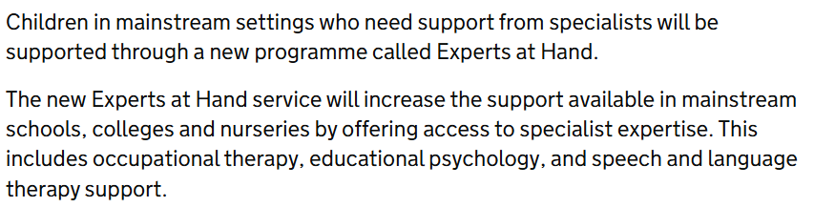
Experts at Hand
At Kiwi, we have the following experts available:
Speech and Language Therapy (3-5 months wait approx.)
Occupational Therapy Referrals (11 months wait approx.)
Educational Psychology support (12 hours per year approx.)
Specialist Educational Needs Service Support (2-3 months approx.)
School Nursing Team Support (ongoing)
Mental Health Support Team (ongoing)

Slide 12
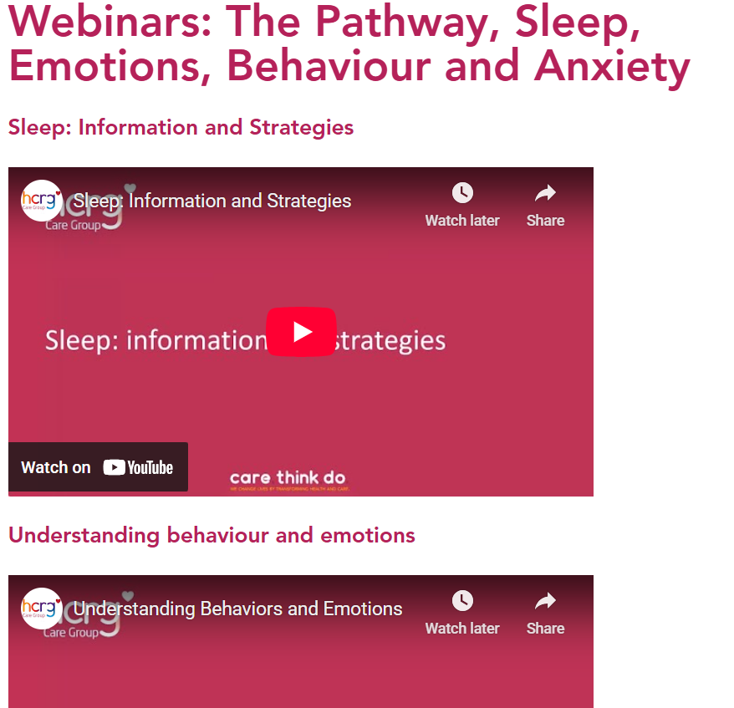
Experts at Hand
School Nursing Team - OAPAL
The school nursing team promote health and wellbeing of all children in school settings. They are involved in school-aged
Health advice and are able to support families with common health and wellbeing difficulties.
Summer Term:
> School Health Needs Assessment
> Parent Cafe for Sleep, Diet, Toileting and Behaviour
Webinars for:
Sleep
Behaviour and Emotions
Neurodevelopmental Pathway
Anxiety and Worries
To contact the school nursing team directly:
Single point of access: 0300 247 0090 – Option 1
Webinars: The Pathway, Sleep, Emotions, Behaviour and Anxiety - BSW Integrated Community Based Care

Slide 13

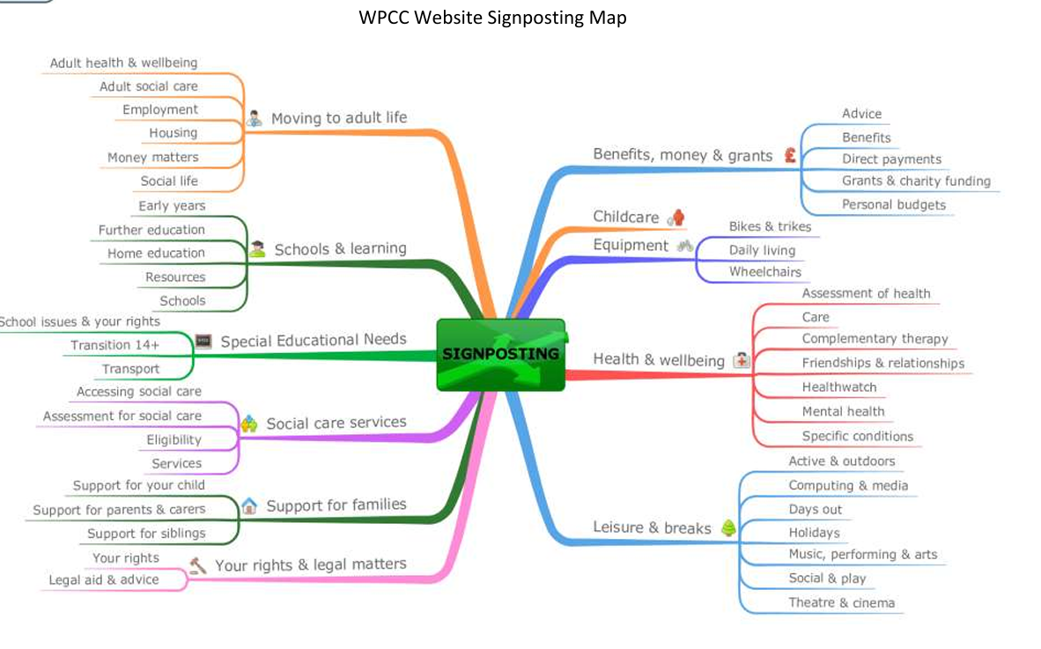
Experts at Hand
Wiltshire Parent Carer Council
Signposting - WPCC

Slide 14
Experts at Hand
Mental Wellbeing Support Structure - OAPAL
At Kiwi we have a robust layered support for our children's mental wellbeing:
Emotional Literacy Support Assistance (6 weeks) can be extended to 12 week
Mental Health Support Team / Wiltshire Children and Young People Wellbeing Service (Referral Led Process)
Time to Talk (6-12 week block)
Play Therapy (Needs based length of provision)
CAMHS (Referral Led Process)

Slide 15

Wiltshire Mental Health Support Team

Slide 16


Who are we?
We are a team of professionals who deliver low intensity mental health support within schools.
We offer individual CBT-informed sessions.
We offer groups and workshops.
We support schools with their Whole School Approach to mental health and wellbeing
Notes:
Zach
To access 1:1 support from us, speak to your school's mental health lead.
CBT-informed sessions – mention that this means we focus on the here and now rather than where the difficulties stem from. We focus on our thinking patterns and behaviours, and the impact these have on our emotions. We will discuss this more later.

Slide 17
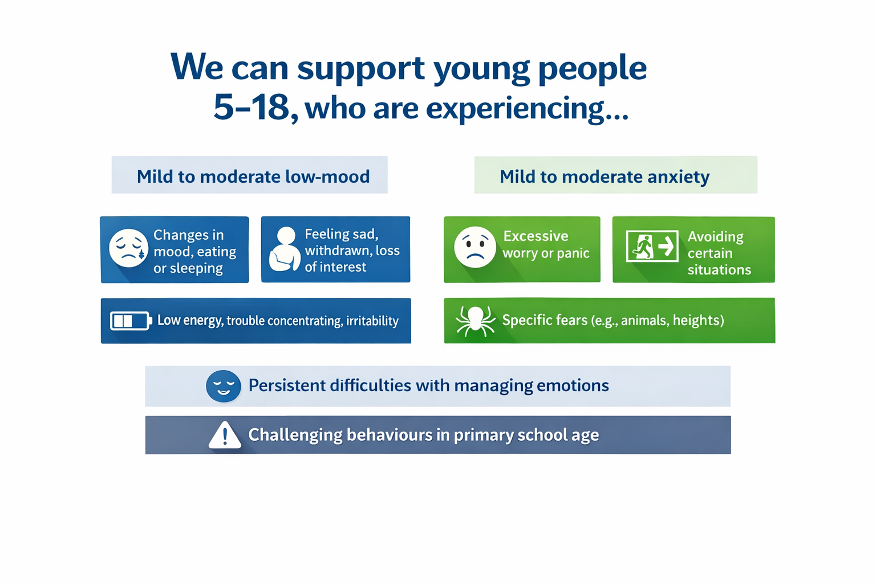
Notes:
Zach
To access 1:1 support from us, speak to your school's mental health lead.
CBT-informed sessions – mention that this means we focus on the here and now rather than where the difficulties stem from. We focus on our thinking patterns and behaviours, and the impact these have on our emotions. We will discuss this more later.

Slide 18
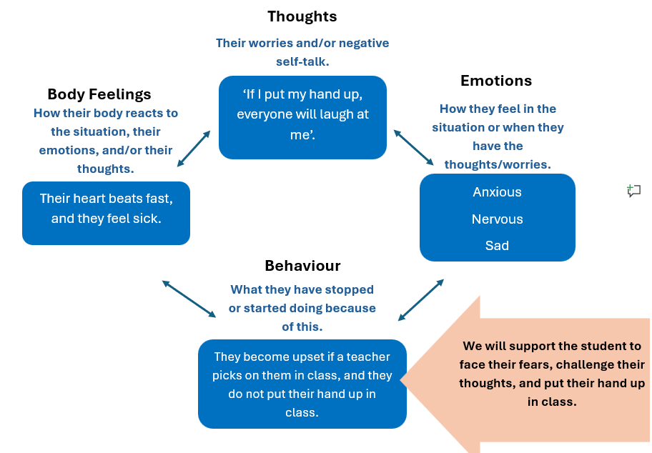
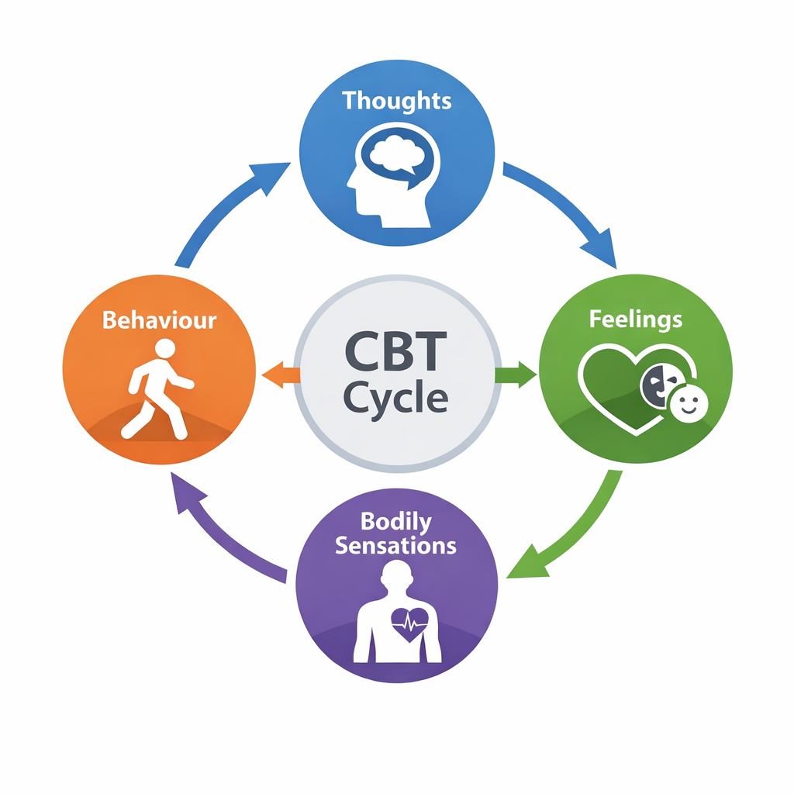
WHAT IS CBT: Cognitive behavioural therapy (CBT) aims to support young people to challenge how they think or behave in a situation.

Slide 19
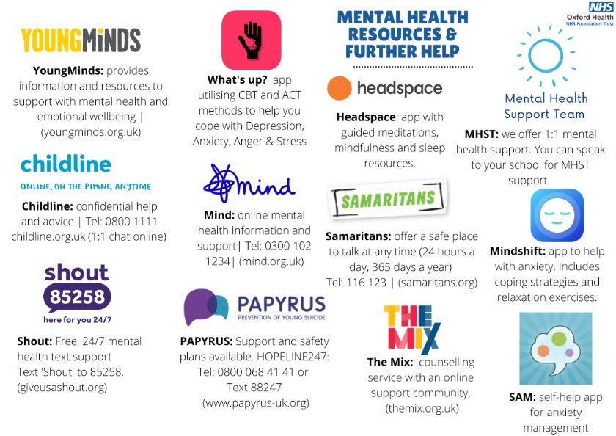

Other support YOU can access…

